Slide 1

Prep Talk:
AI-Powered Career Guidance

Slide 2
Group No. 38
Rahi Agarwal 9921103145
Yashi Ratnakar 9921103011
Armaan Sharma 9921103165

Slide 3

Problem Statement
Personalized Guidance
Reliable Resources
Students, job seekers, and professionals struggle to find personalized and reliable career guidance.
The challenge is to develop a platform that integrates AI and NLP to provide personalized mentorship, real-time communication, and the latest job-related resources.

Slide 4

Introduction and History
1
Prep Talk
Prep Talk is a comprehensive platform designed to assist users in preparing for interviews.
2
AI and NLP
It leverages AI and NLP to provide personalized guidance, connects users with mentors, and delivers curated job-related content.
3
AI Chatbot
The platform also features an AI chatbot for instant interaction, providing answers to user queries and real-time feedback for mock interviews.

Slide 5

Research Paper 1
Artificial Intelligence for Career Guidance – Current Requirements and Prospects for the Future
(IAFOR Publications, 2021)
1
Problem Statement
2
Methodology
3
Results
The gap between higher education and employment services is difficult to bridge due to a lack of scalable, personalized career guidance.
Focus groups with students and professionals, scenario-based trials on integrating AI in career systems, and qualitative analysis on AI's capabilities and limitations.
AI can deliver scalable, personalized guidance, ethical and privacy concerns remain a barrier, AI helps match skills with job requirements effectively.

Slide 6
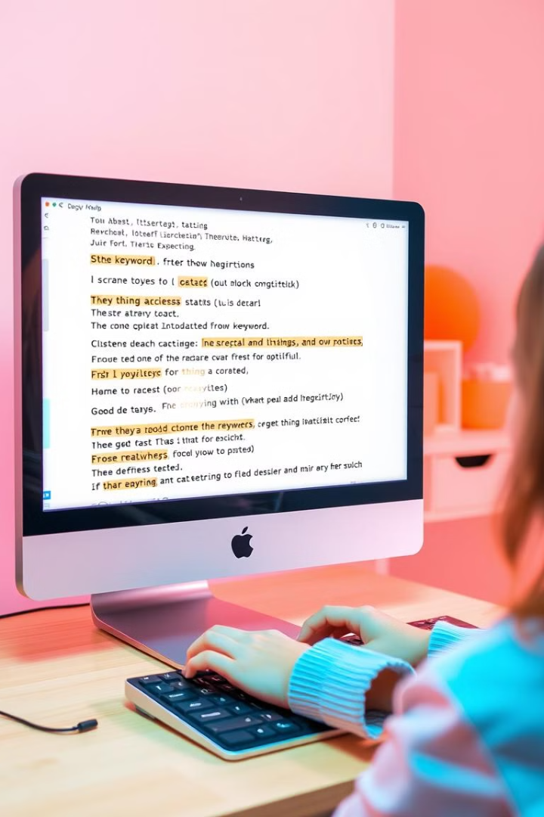
Research Paper 2
Natural Language Processing for Interview Preparation
(ERIC, 2021)
1
Problem Statement
NLP can improve the interview preparation process by extracting relevant information from interview feedback and job descriptions.
2
Methodology
Named Entity Recognition (NER) to identify key terms, sentiment analysis to gauge the interview experience, text summarization for concise feedback.
3
Results
NLP organizes interview questions by category, sentiment analysis highlights candidate experiences, text summarization speeds up insights from lengthy reviews.

Slide 7
State of the Art
AI Chatbots
Leveraging natural language models (e.g., Gemini API) to provide real-time career advice and mock interview simulations.
NLP Models
Extracting and summarizing job descriptions and interview experiences.
Web Scraping
Using Selenium to gather up-to-date job-related data from platforms like Glassdoor and LinkedIn.
Mentor Chatroom
Providing real-time communication between students and industry professionals for personalized guidance.

Slide 8
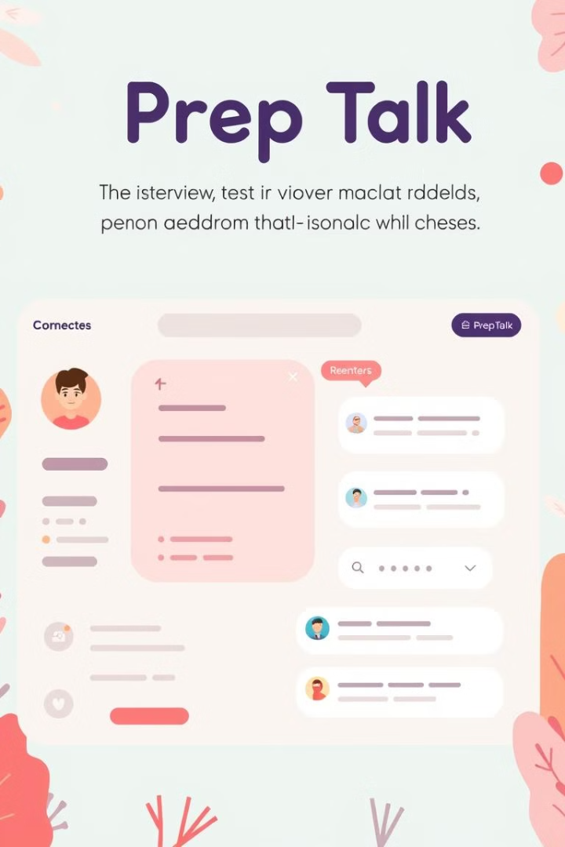
Proposed Solution and Why
AI-Driven Interview Preparation
Prep Talk aims to create a unified platform that offers AI-driven interview preparation.
Personalized Guidance
Personalized guidance via mentor chatrooms and NLP-powered feedback from real interview experiences.
Efficiency
Reduces the need for human intervention in the initial interview preparation process.
Personalization
Offers targeted resources and guidance based on user profiles and job descriptions.

Slide 9





System Workflow
User Inputs
Users log in and provide personal career data (e.g., job interest, previous experience).
Data Collection
Backend scrapes relevant job listings and interview reviews (via Selenium).
Processing
NLP extracts key details, summarizes content, and sends real-time updates to the user.
Mentor Interaction
Users can interact with mentors via a chatroom for personalized advice.
AI Chatbot
The AI bot simulates interview questions and provides feedback using NLP.

Slide 10
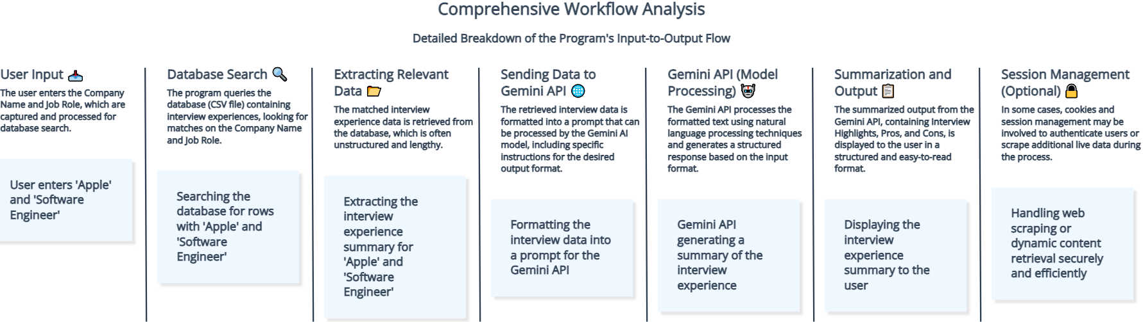
AI Bot Workflow

Slide 11
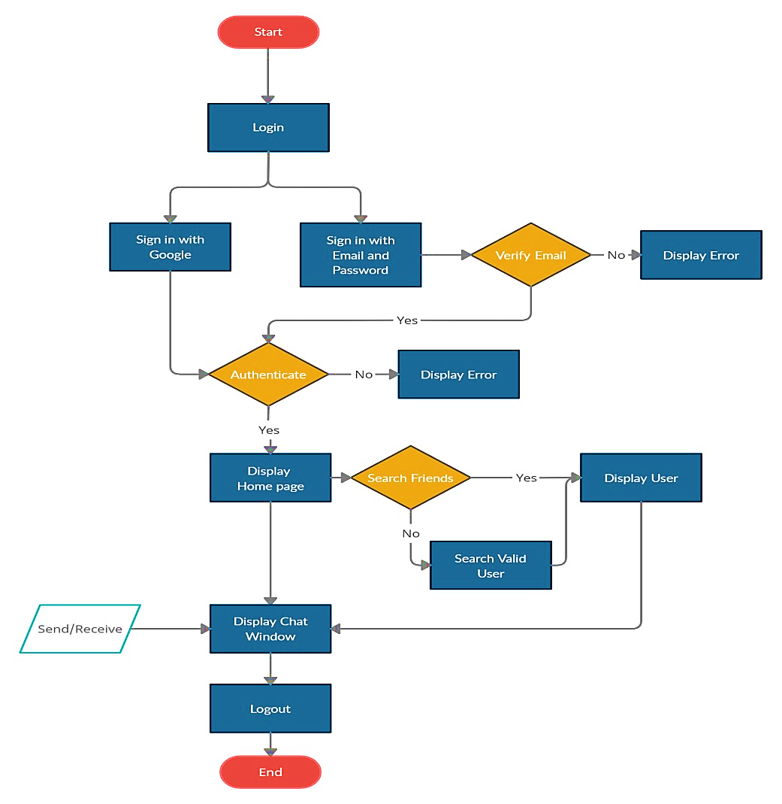
Chat Room Workflow
Login:
The user starts by logging in through either Google or Email and Password.
Verify Email (for email sign-in):
The system checks if the email is valid. If not, an error is displayed.
Authenticate:
After verifying the email or Google sign-in, the system authenticates the user. If authentication fails, an error message is shown.
Display Home Page:
Once authenticated, the user is taken to the home page where they can search for friends.
Search Friends:
The system searches for friends. If found, it displays the user; otherwise, it searches for valid users.
Display Chat Window:
Once a user is found, the chat window is displayed for message exchange.
Logout:
The user can log out, ending the session.
End:
The process concludes when the user logs out.

Slide 12
Architecture
Backend
Handles user data, scraping, and interaction with APIs (e.g., News API, job listings).
Frontend
Presents chatrooms for mentors, AI chatbot for real-time interaction, and career updates.
Database
Stores user data, scraped information, mentor logs, and NLP-processed insights.
Planning Stages
Stage 1
Data collection and initial architecture design.
Stage 2
Integration of NLP models and chatbot.
Stage 3
Frontend development for real-time updates and mentor interaction.

Slide 13
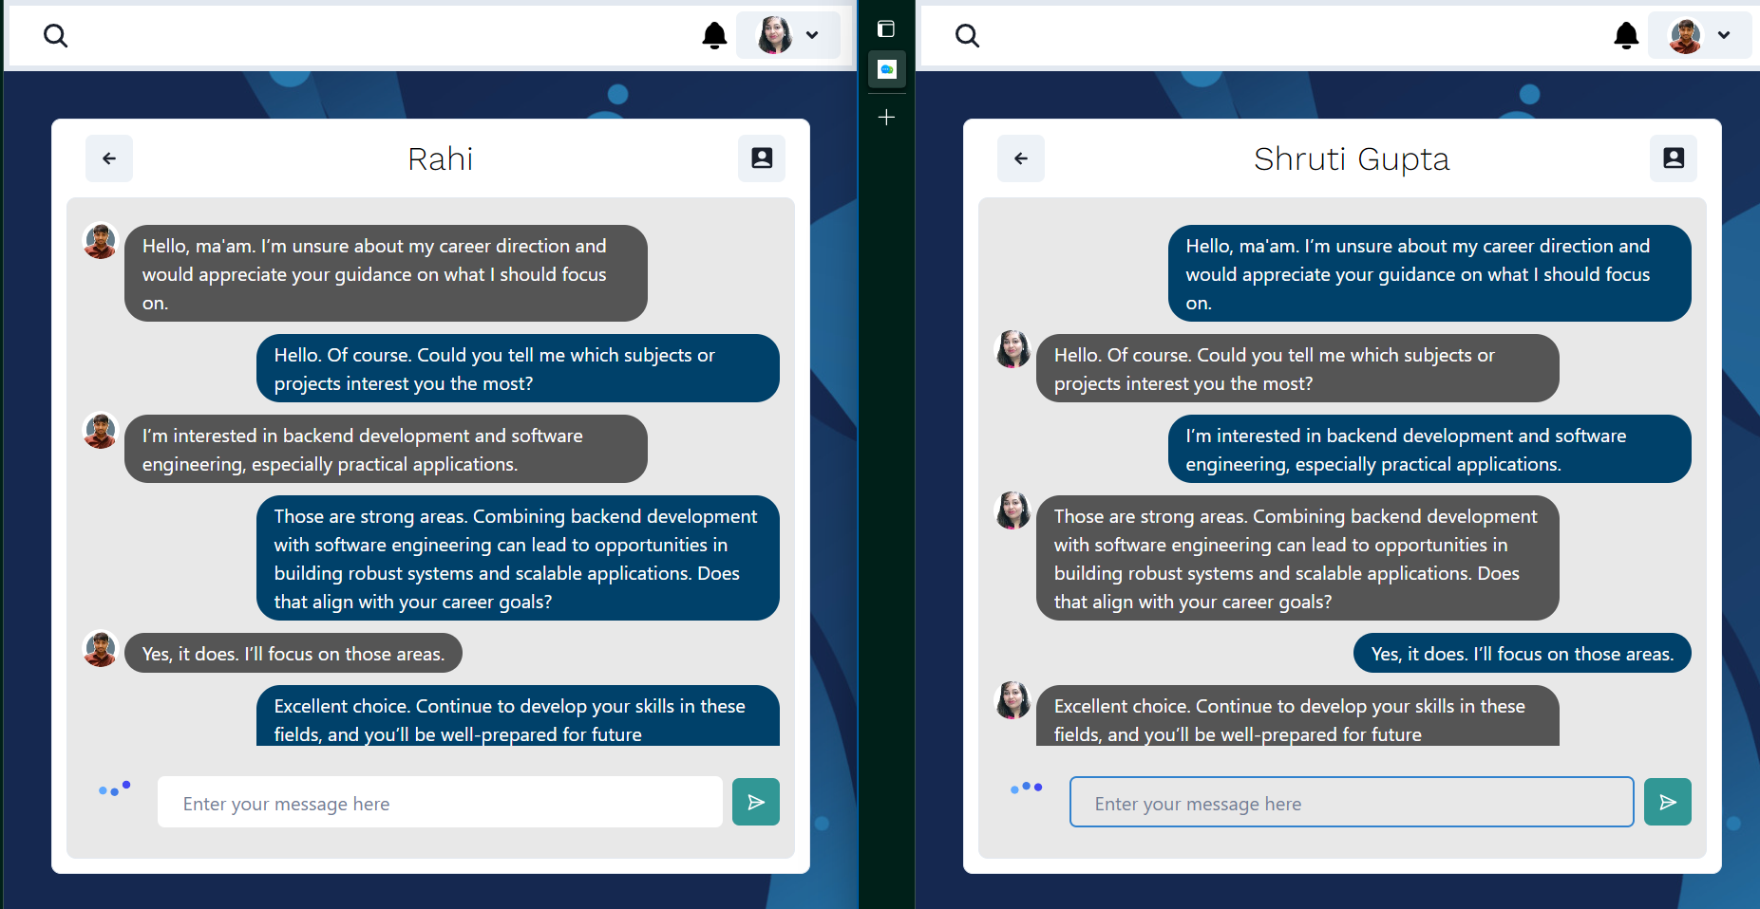
Implementation: Mentor Chat Room

Slide 14
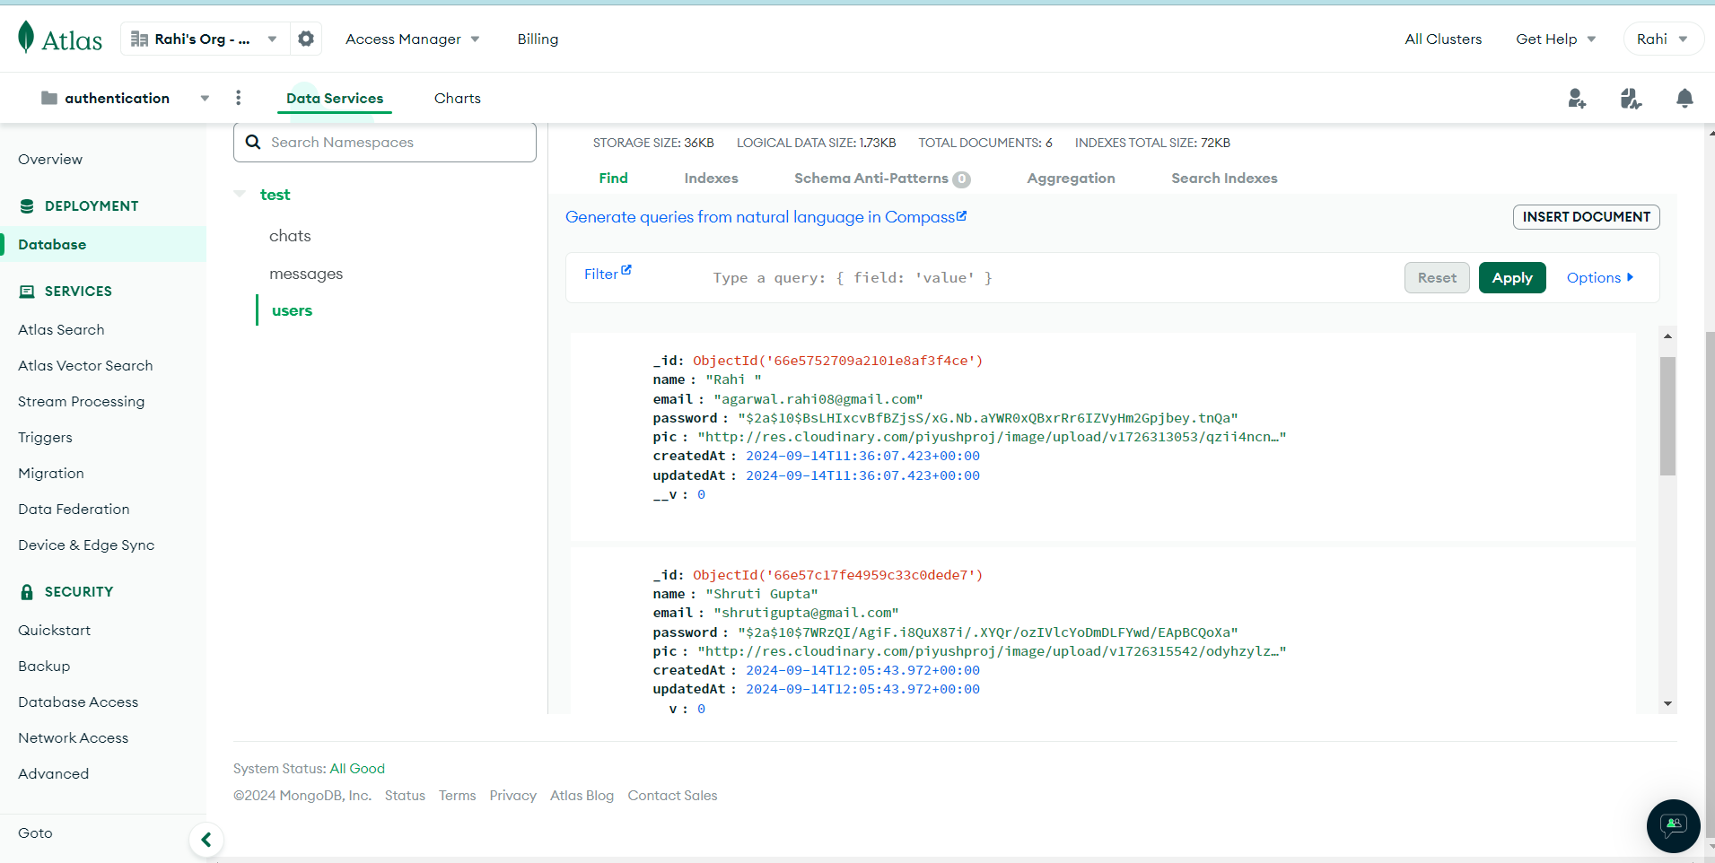
Implementation: Backend Database

Slide 15
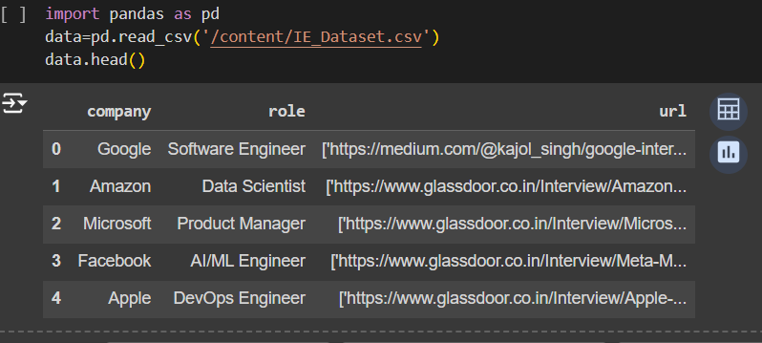
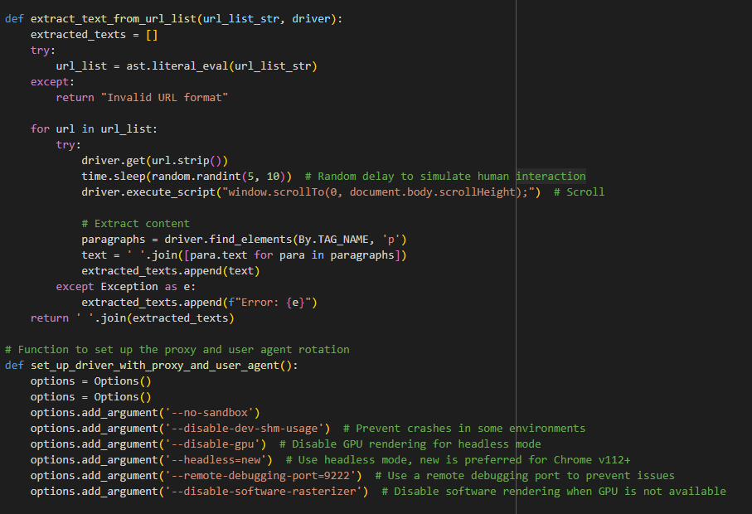
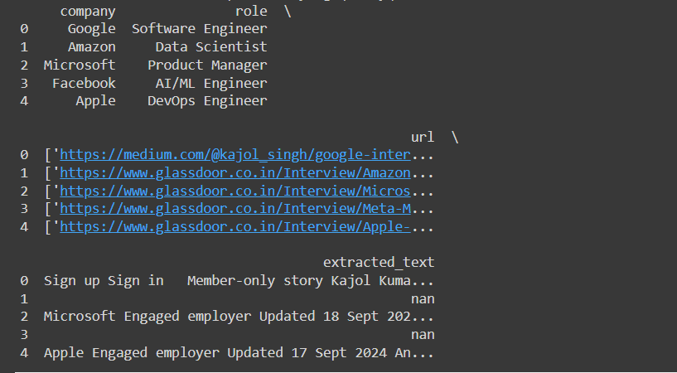
Implementation: Text Extraction using Selenium and Web driver

Slide 16
Tools Used
Frontend
Chakra UI and React.js for the UI/UX.
Backend
Node.js, Express.js, Web Socekt, Flask and Django for API services.
Web Scraping
Selenium for job listings and interview reviews.
AI Chatbot
Fine tuned Gemini API for our purpose.
Database
MongoDB to store interview feedback and user data.
Milestones
Completion of data scraping functionality.
Successful integration of NLP models.
Deployment of mentor chatroom.

Slide 17

Future Scope
1
Expansion of NLP Features
Integrating more advanced NLP techniques for video interview analysis.
2
AI-Powered Resume Review
Adding AI-driven resume screening and feedback.
3
Global Mentor Network
Expanding the mentor pool to include international professionals.
4
Video Interview Preparation
Use computer vision for analyzing soft skills during video interviews.

Slide 18
Conclusion
Prep Talk is a groundbreaking AI-powered platform that simplifies career guidance and interview preparation by combining personalized mentorship, AI-driven feedback, and real-time interaction.
With advanced features like web scraping, NLP-based insights, and AI chatbots, Prep Talk revolutionizes the preparation process, making it accessible, efficient, and tailored to individual needs.

Slide 19
References
[1] IAFOR Publications, "Artificial Intelligence for Career Guidance – Current Requirements and Prospects for the Future," 2021. Available: [2] ERIC, "Natural Language Processing for Interview Preparation," 2021. Available:• A. Wagner, J. Strodthoff, T. Vollmer, R. Schaeffter, and W. Samek, "PTB-XL, a large publicly available electrocardiography dataset," PhysioNet. [https://physionet.org/content/ptb- xl/1.0.3/] [3] M. Szymanski, P. Langowski, and J. Pietka, " Author(s). AI Chatbots in Career Development: Enhancing Interview Preparation," Sensors, vol. 22, no. 3, pp. 1-15, 2023. [https://www.mdpi.com/1424- 8220/22/3/904] [4] P. Vollmer et al., " Author(s). Mentorship Platforms: Integrating AI and Human Interaction for Career Success, 2023” .[https://www.nature.com/articles/s41597- 023-02153- 8?fromPaywallRec=false] [5] Lee, C., & Wang, D. Natural Language Processing for Career Development [https://link.springer.com/article/10.1007/s11042-022-13428-4] [6]Smith, J., & Brown, K. Personalized Career Counseling through AI [https://www.researchgate.net/publication/354171816_Artificial_Intelligence_for_Career_Gu idance_-_Current_Requirements_and_Prospects_for_the_Future]

